Slide 1
Hotel Management System
Submitted By
Pushpa Kumari
Reg No:ADIT19AU03683
NSTI(w)Salt Lake Kolkata

Slide 2
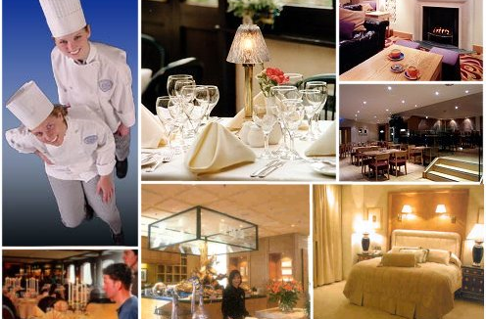
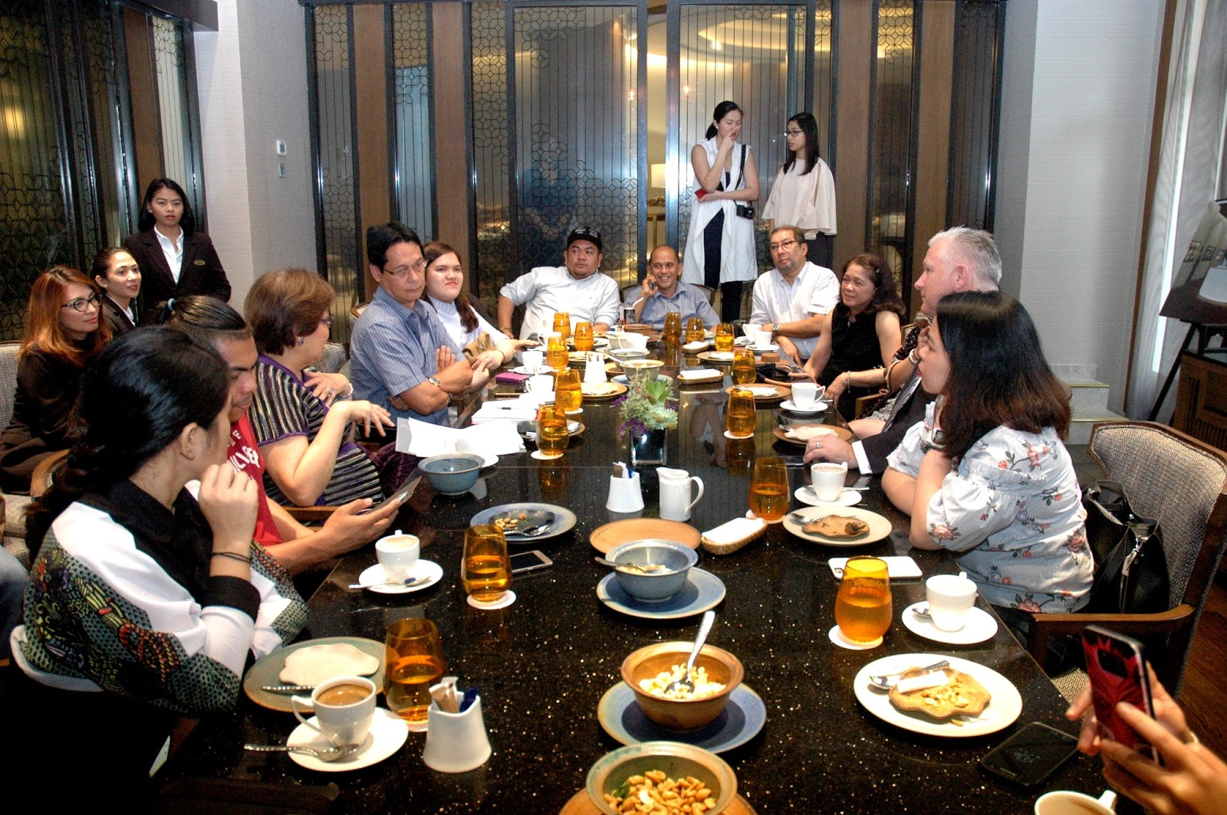

Agenda
Introduction
Purpose of Project
Used Tools & Technology
Used Technology
Used services
Features of Fabulous Hotel
Benefits
Future Work
Deployment Steps
Conclusion

Slide 3
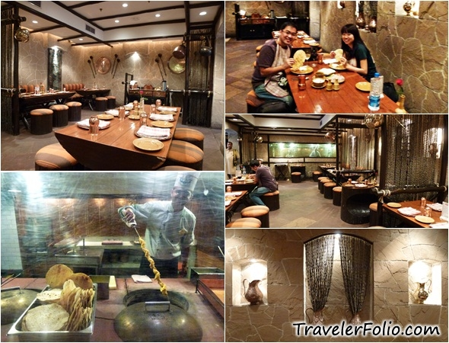
Introduction
This website is created based on Hotel Management System that allows the hotel manager to handle all hotel activities online. Interactive GUI and the ability to manage various hotel food bookings make this system very flexible and convenient. The hotel manager is a very busy person and does not have the time to sit and manage the entire activities manually on paper. This application gives him the power and flexibility to manage the entire system from a single online system. The hotel management project provides foods Order and information about the hotel and food menu, staff management, and other necessary hotel management features. The system allows the manager to post available food in the system. Customers can view and order food online. Admin has the power of either approving or disapproving the customer’s booking request. Other hotel services can also be viewed by the customers and can book them too. The system is hence useful for both customers and managers to portable manage the hotel activities.

Slide 4

Purpose Of Project
Aims of this website to easy to work of hotel work and online start his/her business because online is a medium that grows up and popular any business in a very short time and by this medium easily interact user with your hotel
This Photo by Unknown Author is licensed under CC BY-NC-ND

Slide 5
Used Tools and Software
Used Software
Node.js
VS Code Editor
Used Hardware
Processor: - Intel Core i3 & Higher Version
Operating System: - Windows 10
Memory: - :- 4GB RAM
Hard Disk: - :- 1TB Hard Disk

Slide 6




Used Technology
The Hypertext Markup Language, or HTML is the standard markup language for documents designed to be displayed in a web browser. It can be assisted by technologies such as Cascading ...
Cascading Style Sheets (CSS) is a style sheet language used for describing the presentation of a document written in a markup language such as HTML. CSS is a cornerstone technology ...
JavaScript, often abbreviated as JS, is a programming language JavaScript is high-level, often just-in-time compiled, and multi-paradigm. It has curly-bracket syntax, dynamic typing, prototype-based object-orientation, and first-class functions
Node.js is an open-source and cross-platform JavaScript runtime environment. It is a popular tool for almost any kind of project! Node.js runs the V8 JavaScript engine, the core of Google

Slide 7
Used Services

Slide 8

MongoDB Atlas
MongoDB Atlas is the only database as a service from the team that builds MongoDB. Launching an application on any database typically requires careful planning to ensure performance, high availability, security, and disaster recovery and these obligations continue as long as you run the application. MongoDB Atlas provides all of the features of ...
This Photo by Unknown Author is licensed under CC BY

Slide 9
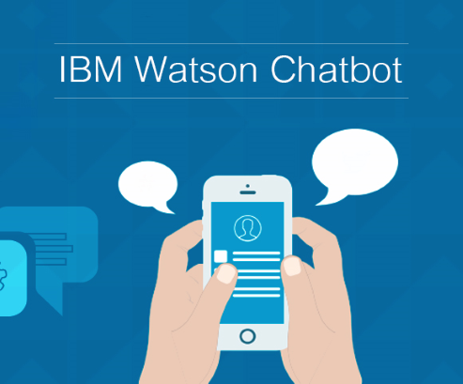
IBM Watson Chatbot
Watson Assistant is the AI chatbot for business. This enterprise artificial intelligence technology enables users to build conversational AI solutions. IBM Watson Assistant - AI Chatbot | IBM

Slide 10
Features of Fabulous Hotel
The user easily to know about hotel and hotel’s special dishes and food menu
In the food menu, users can be known about what is available in breakfast, dinner, main dishes, lunch and deserts dishes and what is the cost of food
our Watson assistant will assist the users
user can be contact and also know about the hotel opening and closing timing.

Slide 11
Benefits
Saves time of customers in quickly order the Food.
The ability to order anytime, from anywhere with Internet access.
Provides the information about hotel facilities.
very secure.
User friendly.
Know about services about the hotel
Easily chat with chatbot and get his/her all query about the food and hotel

Slide 12
Future work
The purpose of the hotel website is to save the users and hotel staff time and as a hotel boss no need to more workers he does his work via few workers.
A clear understanding of the hotel website and its functionality will allow for the correct software to be developed for the end-user and will be used for the development of the future stages of the project.
On our website, there is an option to book a table online but our future plan is to order food online also because we want to provide full customer satisfaction and we are working on that.
Notes:
The purpose of the hotel website is to save the users and hotel staff time and as a hotel boss no need to more workers he does his work via few workers. A clear understanding of the hotel website and its functionality will allow for the correct software to be developed for the end-user and will be used for the development of the future stages of the project. On our website, there is an option to book a table online but our future plan is to order food online also because we want to provide full customer satisfaction and we are working on that.

Slide 13
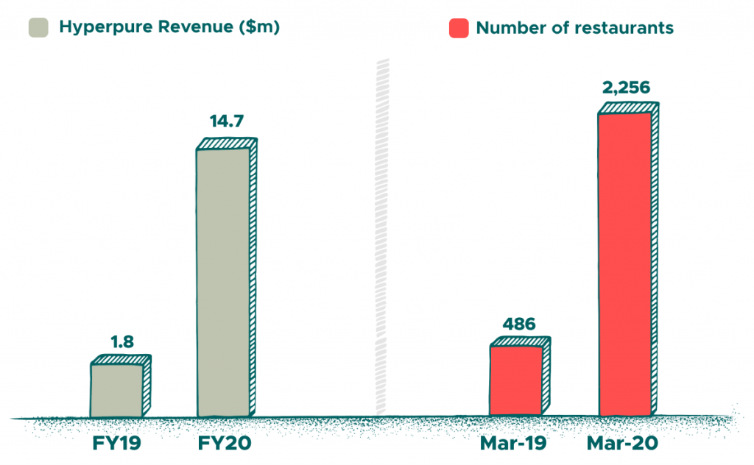
Graph of Hotel

Slide 14
Deployment Steps
Create a web page using Html,Css,Javascript
Create a app.js file write the code & in the code provide the specific port number
Install dependencies of npm like express.js, Ejs , mongoose & body-parser
Execute the code run the command in cli node file name e.g. Node app.js

Slide 15
Conclusion
Hotel management system now-a-day have the advantage of modernization. Computer have done the work more easy.
Computer is playing a important role in management. Reports are made on daily basis for every customer check in or check out which can easily be seen by the management. Hotel management system has also primary purpose is to provide facilities to customers.
A software for computers makes the things many times easy, these are made as user friendly and to keep an check and balance in hotel management and accounts as well. So ,these things are important

Slide 16
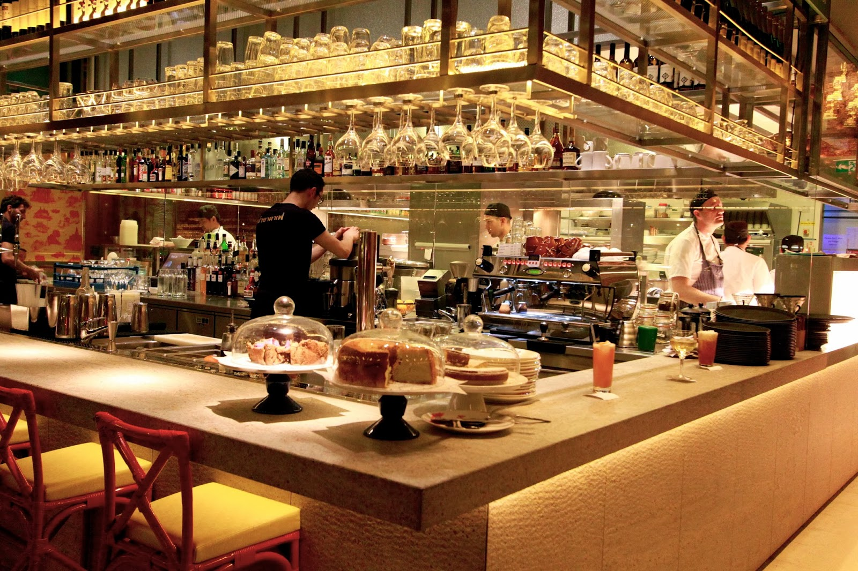
Thank you
Pushpa Kumari
nagatolabyap@gmail.com
Website link:
Hotel Management System
16

